Slide 1
DARK WEB

Slide 2
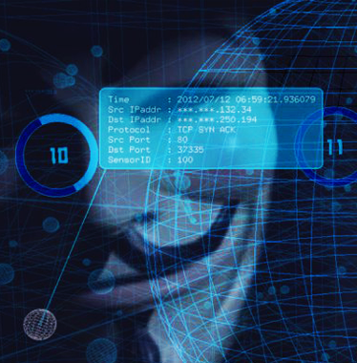
What you think Dark Web is

Slide 3
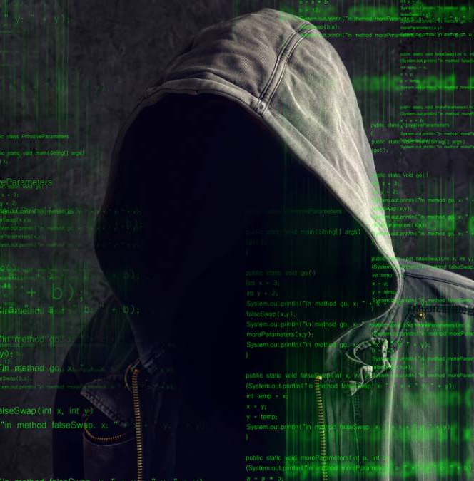
What Dark Web is…..

Slide 4
DARK WEB IS…
Beyond Google and other search engines
Not available in Simple search terms
No .com, .net, .org. They have very weird names like .onion, .mofo, etc..,

Slide 5
Contains Potentially Dangerous stuff
Selling Illegal and Hard core drugs
Weapons and firearms
Fake Ids, Visa permits, Passports
Stolen Credit cards and other data
Child Pornography and much more worse
Hacker’s kit, spam creation etc..,
Pirated software, movies, books, music etc..,
Red room.

Slide 6
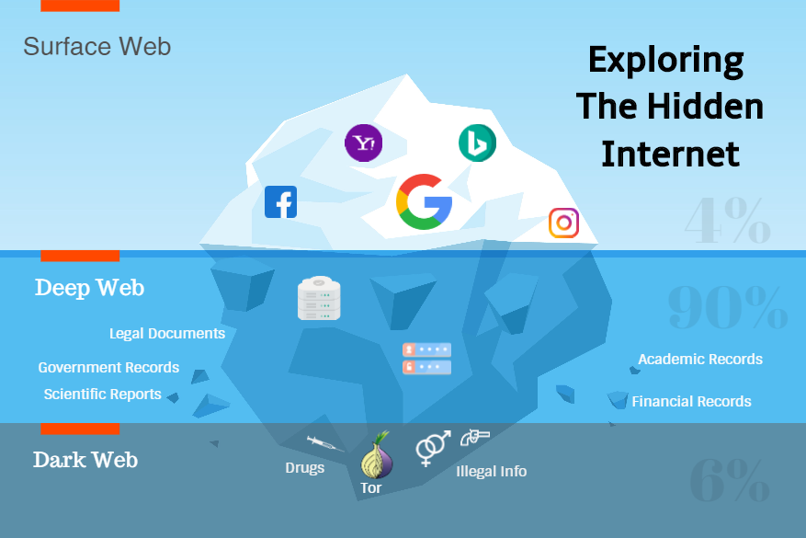

Slide 7
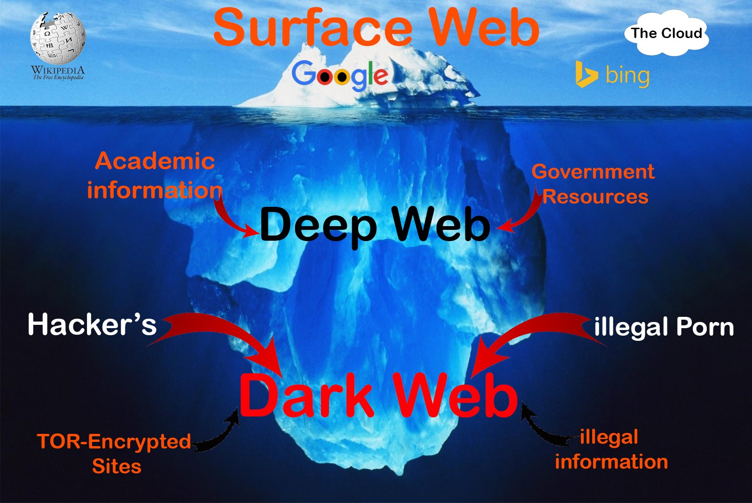

Slide 8
Surface web
Accessible to anyone & open to all Ex: Wikipedia
Indexed & searchable
Least illegal content or zero
You may get some web pages from dark web, but it is just a small part (Not a portal to it) Ex: pirated movies, porn
No personal data required
µTorrent, fmovies etc..,

Slide 9
Deep web
Privileged access Ex: Sign On, Login
Requests your personal info
Facebook, LinkedIn and other social media
Internet Banking
ecommerce
Maintained user profiles for providing personalized experiences.
Personal data is protected under the law
Some data is not indexed by search engines.
Bank transactions
Private/Personal data
Government data

Slide 10
The Dark Web
Sites and webpages are not indexed and accessible easily
NOT accessible via normal browser like chrome, Firefox, opera, safari
TOR enabled browsers (browsers are available on surface web)
TOR - key architectural feature of the dark web.

Slide 11
TOR – THE ONION ROUTER
Was developed in the mid-1990s by United States Naval Research Laboratory. US intelligence services and DARPA (the Defence Advanced Research Projects Agency)
Totally anonymously, and used for both licit and illicit purposes.
Multiple, sequential encryption, or multi-layered encryption like the layers of an onion
Uses packet-switching technology like µTorrent

Slide 12
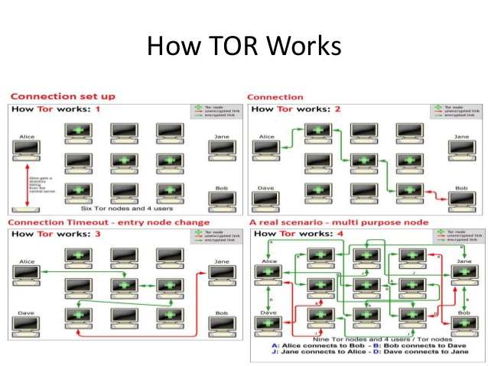

Slide 13
Each server that a data packet passes through encrypts that data packet, and its routing information, with its own encryption key.
So that by the time all the different data packets reach their destination they have each been encrypted multiple times, using different encryption keys.
The routing and the origin of the data packets are effectively unreadable to anyone other than the intended recipient.
This is what gives the data traffic on the dark web its anonymity and secrecy, and it is pretty-much uncrackable.

Slide 14
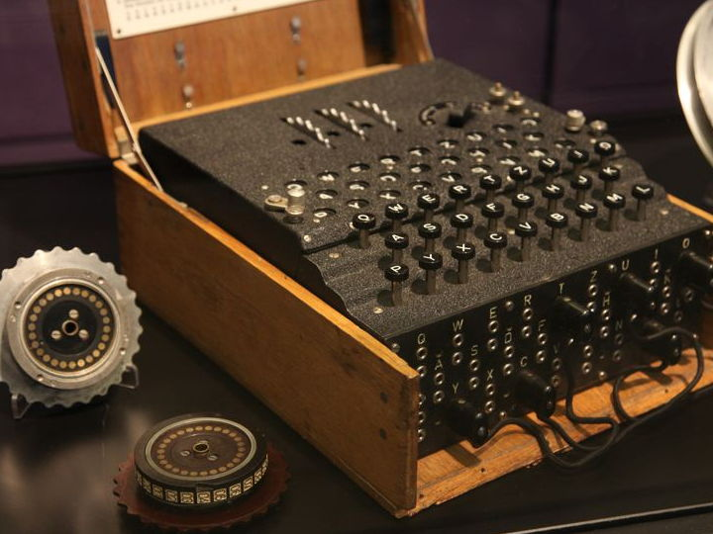
ENIGMA HACK
Hacking was done before the term computer exists
German used Enigma in WORLD WAR I for encrypted communication
Germans increased its security at the outbreak of war by changing the cipher system daily
Looks like typewriter
Encrypted Morse code
Single key encryption

Slide 15
Alan Turing
Turing developed a complex code-breaking technique he named ‘Turingery’.
This method fed into work by others in understanding the ‘Lorenz’ cipher machine.
Lorenz enciphered German strategic messages of high importance: the ability to read these contributed greatly to the Allied war effort.

Slide 16
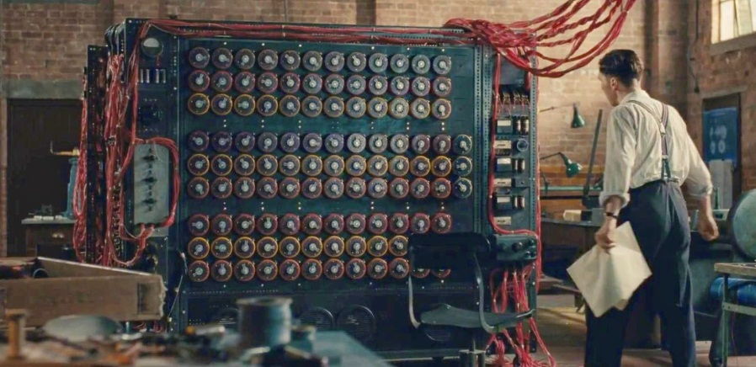
Turing machine

Slide 17
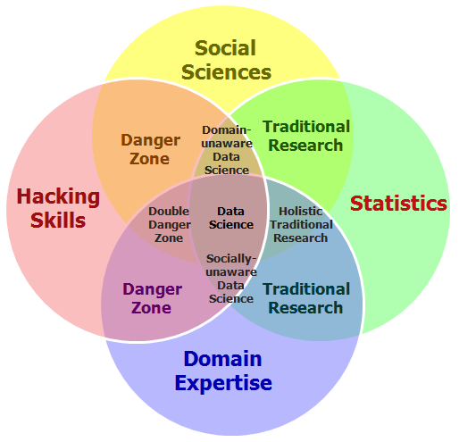
Who hacks?

Slide 18
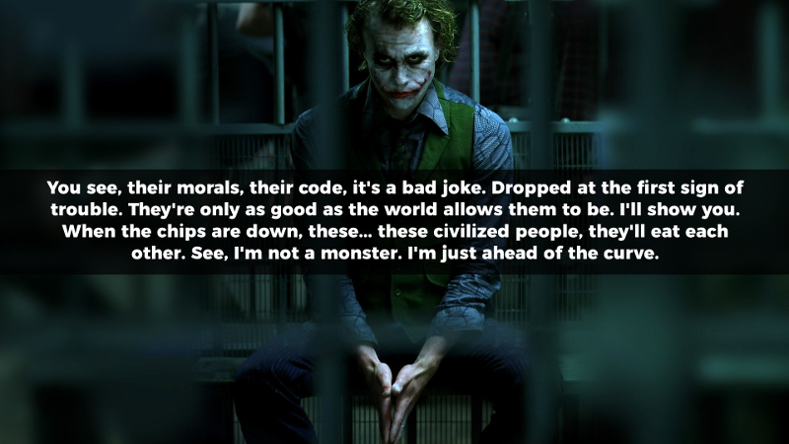
- Joker, The Dark Knight

Slide 19
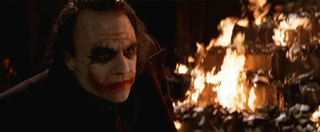

Slide 20
Gultoo Deep Web

